Slide 1
Taking your Oral Presentations to a Higher Level
David H. Spach, MD Professor of Medicine Division of Infectious Diseases University of Washington, Seattle
Notes:
1

Slide 2
Taking your Oral Presentations to a Higher Level
WHY DOES IT MATTER???
Notes:
1

Slide 3
Types of Oral Presentations
Informal small group
Research Presentation/ Research Meeting
Clinical Conference/Clinical Review
Formal “Grand Rounds” Venue
Notes:
1

Slide 4
Outline for Session
Preparing for the Presentation
Enhancing Retention of Information
Presentation Delivery
Power Point Tips
Notes:
1

Slide 5
Preparing for the Presentation
Notes:
1

Slide 6
Factors Likely to Impact Presentation
Delivery 25%
Preparation 75%
Notes:
1

Slide 7
Preparing for the Presentation
Understand your Audience
Know the Setting/Type of Presentation
Know your Material
Determine the Desired Outcome
Notes:
1

Slide 8
Exercise/Example
You have been asked to give an review of current sexually transmitted diseases (STD) Guidelines at a regional CME conference. The audience includes primary care MDs (IM and FP), ARNPs, PAs, and the medical staff from the local Health Departments, including about 10 nurses.
It is estimated that 100 persons will attend the talk.
The title of the talk is What’s New in STDs.
Notes:
1

Slide 9
“Outcomes” Related to a Presentation
What do you want to achieve with your presentation?
Notes:
1

Slide 10
“Outcomes” Related to a Presentation
Transfer of specific knowledge/information
Enhance understanding of concepts
Gain new insight
Stimulate interest in subject
Change behavior/practice
Notes:
1

Slide 11
“Outcomes” Related to a Presentation
Change behavior/practice
Stimulate interest/motivate
Gain new insight
Enhance understanding of concepts
Transfer of knowledge/information
Notes:
1

Slide 12
“Outcomes” Related to a Presentation
Change behavior/practice
Stimulate interest/motivate
Gain new insight
Enhance understanding of concepts
Transfer of knowledge/information
IMPACT
Notes:
1

Slide 13
Example/Exercise
Notes:
1

Slide 14
Know your Audience
How do you optimize your presentation for a mixed audience?
Notes:
1

Slide 15
Strategies with a Heterogeneous Audience
Use real examples/case studies if possible
Present material step-wise in level of difficulty
Involve audience to allow different types of questions
Notes:
1

Slide 16
Strategies with a Heterogeneous Audience
Advanced
Advanced
Intermediate
Intermediate
Basic
Basic
Notes:
1

Slide 17
Enhancing Retention of Information
Notes:
1

Slide 18
Exercise/Example
MODEL X car and collisions
Notes:
1

Slide 19
MODEL X Car and Collisions
Results from Front End Collisions
Speed of Collision (mph) | Compression of Exterior Frame (%)
10 | 14
20 | 30
30 | 64
Notes:
1

Slide 20
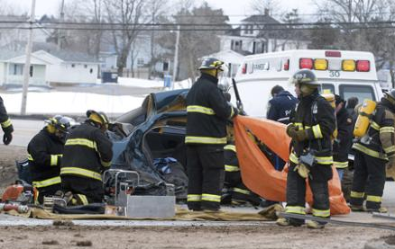
MODEL X Car and Collisions
Here is what happens with a 30 mile per hour front end collision with MODEL X car.
Notes:
1

Slide 21
MODEL X Car and Collisions
In front end collisions, MODEL X car has a 64% compression of the exterior frame with a 30 mile per hour collision.
Notes:
1

Slide 22
MODEL X Car and Collisions
What do you remember?
What do you conclude about Model X and collisions?
Notes:
1

Slide 23
MODEL X Car and Collisions
What do you think the purpose goal was of each of the slides?
Notes:
1

Slide 24
MODEL X Car and Collisions
What do you think the purpose goal was of each of the slides?
Relationship
Concept
Fact
Notes:
1

Slide 25
How do you enhance audience retaining information?
Notes:
1

Slide 26
Awareness of HIV Status
In the United States, it is estimated that 21% of HIV-infected persons are unaware of their status.
Notes:
1

Slide 27
Significance of Awareness of HIV Status?
Unaware of HIV infection
21%
Aware of HIV infection
79%
Notes:
1

Slide 28
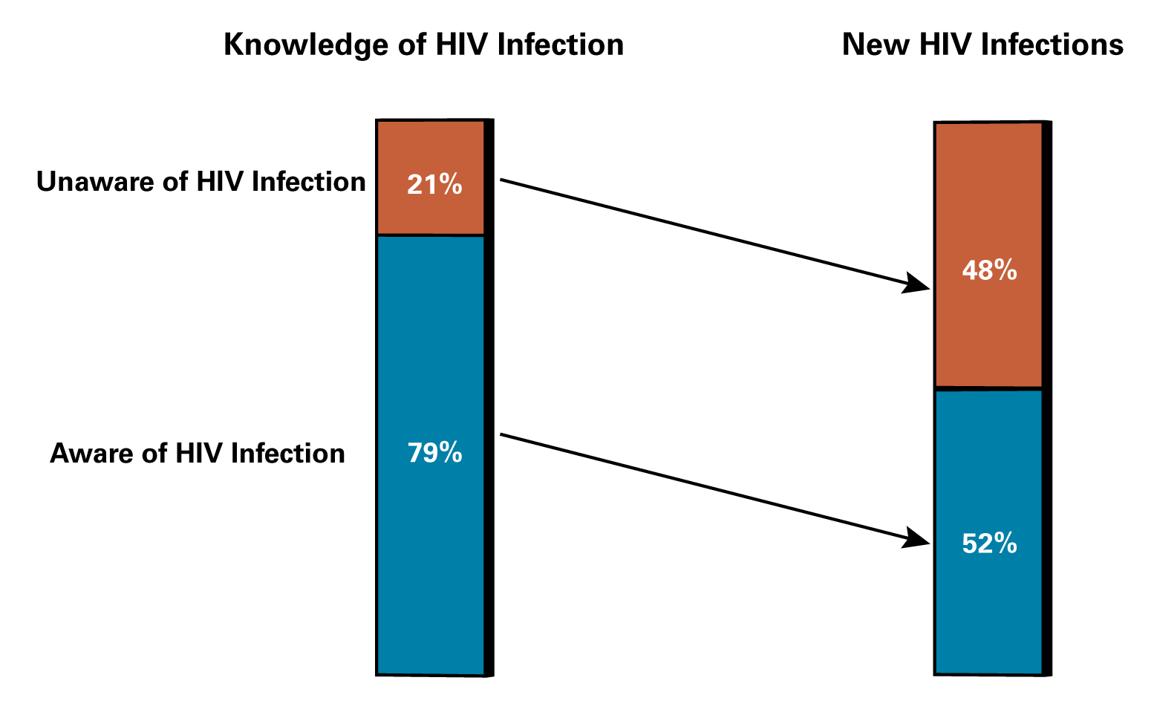
Using Marks Model and 2008 CDC Data Estimating Impact of Knowledge of HIV Infection on Sexual Transmission of New HIV Infections
Using Marks Model & 2008 CDC Estimates of Awareness of HIV Status
Knowledge of HIV Infection
New HIV Infections
Unaware of HIV Infection
Aware of HIV Infection
Estimates Based on: Marks G, et al. AIDS. 2006;20:1447-50.
Notes:
1

Slide 29
Enhancing Retention
Repeat Material
Make it Relevant
Notes:
1

Slide 30
Enhancing Retention
Activate Visual Memory
Stimulate Emotion
Notes:
1

Slide 31
Awareness of HIV Status
Aware of HIV Infection
Unaware of HIV Infection
TRANSMISSION OF HIV
Notes:
1

Slide 32
Awareness of HIV Status
Unaware of HIV Infection
TRANSMISSION OF HIV
How do we decrease HIV transmission in persons unaware of their HIV status?
Notes:
1

Slide 33
Enhancing Retention
Repeat Material
Activate Visual Memory
Make it Relevant
Stimulate Emotion
Notes:
1

Slide 34
Case History
Approximately what percentage of persons living with HIV in the United States are unaware of their HIV status? A. 2%
B. 5%
C. 20%
D. 40%
Notes:
1

Slide 35
Enhancing Retention
Repeat Material
Activate Visual Memory
Make it Relevant
Stimulate Emotion
Assess/Test
Notes:
1

Slide 36
Presentation Delivery
Notes:
1

Slide 37
Enhancing Presentation Delivery The Four P’s
Preparation (room and AV equipment)
Projection
Pauses
Performance
Notes:
1

Slide 38
Answering Questions
Examples
Notes:
1

Slide 39
Power Point*
*Your best friend? *Your worst enemy?
Notes:
1

Slide 40
December 2009 ARV Guidelines When to Initiate ARV Therapy
Initiate in all patients with a history of an AIDS-defining illness or with a CD4 count <350 cells/mm³ (AI).
Initiated, regardless of CD4 count, in patients with the following conditions: pregnancy (AI), HIV- associated nephropathy (AII), and hepatitis B virus (HBV) coinfection when treatment of HBV is indicated (AIII).
Recommended for patients with CD4 counts between 350 and 500 cells/mm³. The Panel was divided on the strength of this recommendation: 55% voted for strong recommendation (A) and 45% voted for moderate recommendation (B) (A/B-II).
For patients with CD4 counts >500 cells/mm3, the Panel was evenly divided: 50% favor starting antiretroviral therapy at this stage of HIV disease (B); 50% view initiating therapy at this stage as optional (C) (B/C-III).
Patients initiating antiretroviral therapy should be willing and able to commit to lifelong treatment and should understand the benefits and risks of therapy and the importance of adherence (AIII). Patients may choose to postpone therapy, and providers, on a case-by-case basis, may elect to defer therapy based on clinical and/or psychosocial factors.
Notes:
1

Slide 41
Speaker Goals for Session
Change your approach to preparing for a lecture
Increase use of images to enhance presentation
Improve presentation delivery
Stimulate your interest to improve as a speaker
Notes:
1

Slide 42
Speaker Goals for Session
Change your approach to preparing for a lecture
Increase use of images to enhance presentation
Improve presentation delivery
Stimulate your interest to improve as a speaker
Notes:
1

Slide 43
Notes:
1

Slide 44
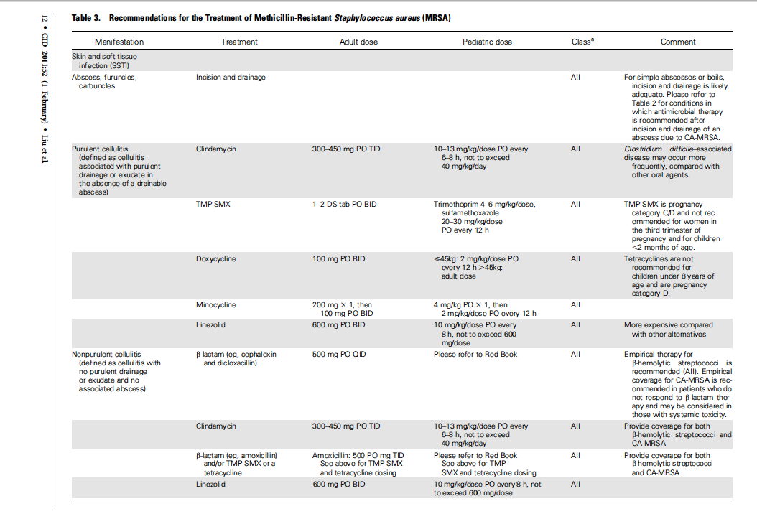
December 2009 ARV Guidelines When to Initiate ARV Therapy
Notes:
1

Slide 45
December 2009 ARV Guidelines When to Initiate ARV Therapy
I know you can’t read what is on this slide, but…….
Notes:
1

Slide 46
Transitions
Notes:
1

Slide 47
Transitions
Notes:
1

Slide 48
Enhancing Presentation Delivery The Four P’s
Preparation (room and AV equipment)
Projection
Pauses
Performance
Outline/Prompt
Notes:
1

Slide 49
Important North American Ticks
Ixodes Female (Adult)
Ixodes Male (Adult)
Ixodes Nymph
Amblyomma Female (Adult)
Dermacentor Female (Adult)
Ornithodoros (Adult)
From: Spach DH et al. N Engl J Med. 1993;329:936-47.
Notes:
1

Slide 50
Vancomycin: Mechanism of Action
Vancomycin
Cell Wall Synthesis
DNA
Notes:
1

Slide 51
Graphics
Notes:
1

Slide 52
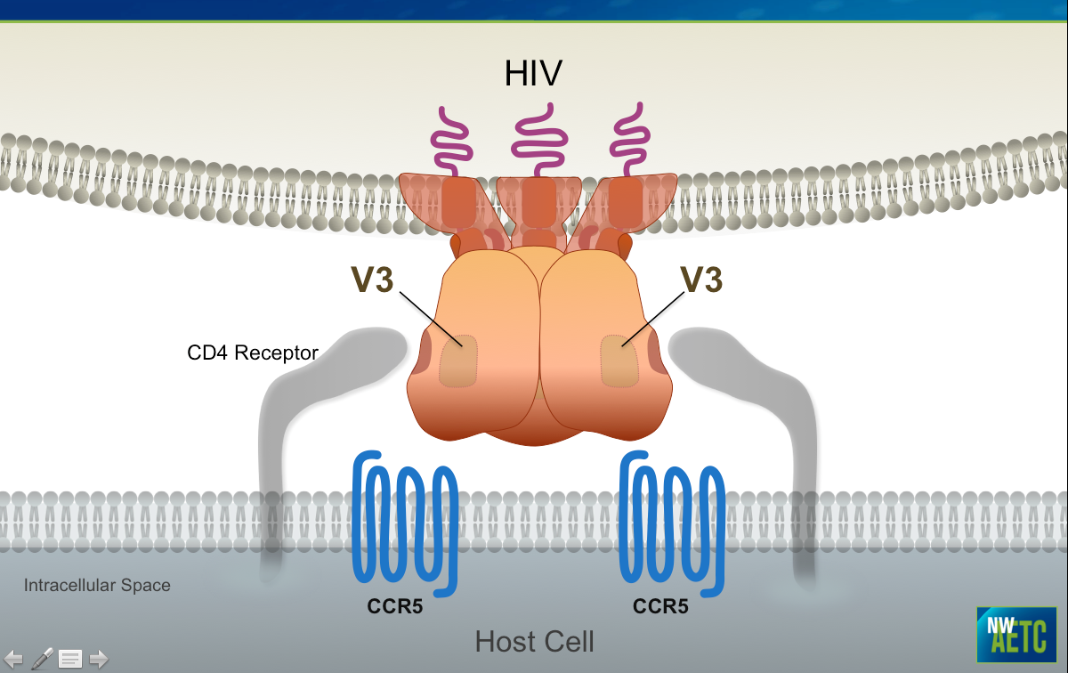
Notes:
1

Slide 53
Wrap Up
Notes:
1

Slide 54
“Outcomes Related to a Presentation”
Change behavior/practice
Stimulate interest/motivate
Gain new insight
Enhance understanding of concepts
Transfer of knowledge/information
Notes:
1

